Slide 1
Ohio Confederation of Teacher Education Organizations (OCTEO)
2025
Teaching (and Learning) in the Age of AI
Sherrill L. Sellers, M. Todd Edwards, & Ann Haley MacKenzie
Miami University, College of Education, Health and Society
Notes:
Sherrill

Slide 2
Part 1: Why We're Here (GenAI)
GenAI
AI in Education
Let’s play
Q & A
Resources
Our goal is to shift the room from AI talk to AI practice.
Try 3 tools with your own content
Teach with limits + ethics in view
Leave with a ready-to-use plan
Notes:
Todd
Explore how generative AI is reshaping teaching, learning, and research through hands-on tools, real-world examples, and conversations about ethics, equity, and educational innovation.

Slide 3
Ground Rules
GenAI
AI in Education
Let’s play
Q & A
Resources
As we collaborate, be mindful of the following operating procedures:
Try first, judge later: short sprints; show what you tried.
Use safe content: no student PII or confidential files; only material you own or is licensed.
Privacy on: use demo accounts; turn off chat history/training where possible.
Be transparent: mark AI-assisted work; note tool/model/date; keep prompts for reproducibility.
Respect the room: share time, help neighbors; captions on & headphones low; photos/recordings are opt-in.
Notes:
Todd

Slide 4
Part 2: AI in Education
GenAI
AI in Education
Let’s play
Q & A
Resources
Challenges
The limitations of probability-based prediction
AI-based hallucinations
Ethical and environmental concerns
Notes:
Sherrill
Explore how generative AI is reshaping teaching, learning, and research through hands-on tools, real-world examples, and conversations about ethics, equity, and educational innovation.

Slide 5
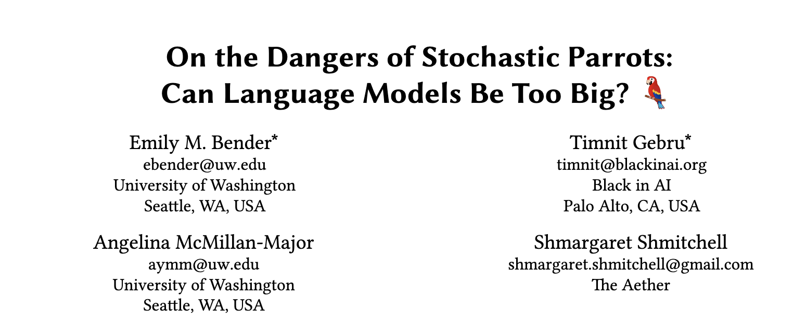
GenAI
AI in Education
Let’s play
Q & A
Resources
No Intelligence: Probability-based Prediction
Source: Bender, Emily. M., Gebru, Timnit., McMillan-Major, Angelina., & Shmitchell, Shmargaret. (2021). https://doi.org/10.1145/3442188.3445922
Notes:
Sherrill

Slide 6
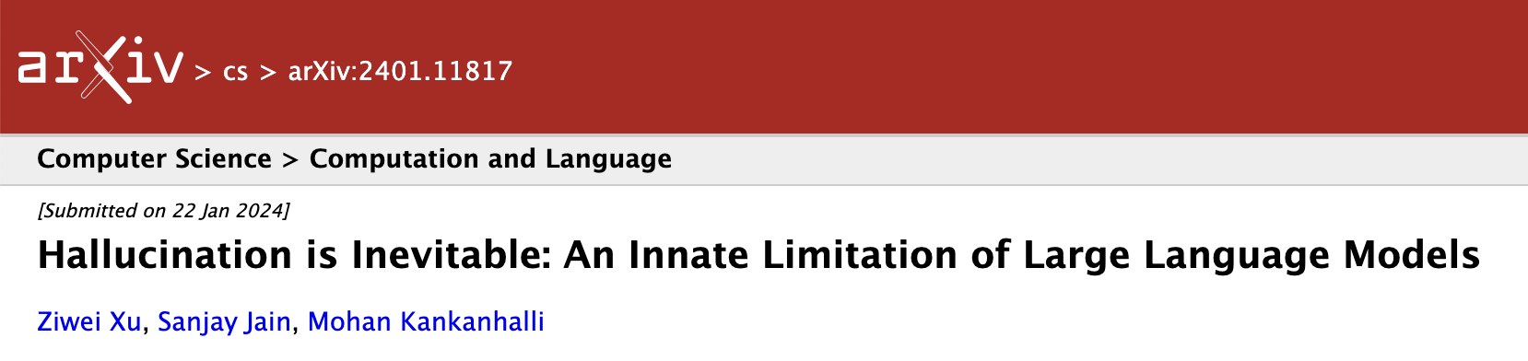
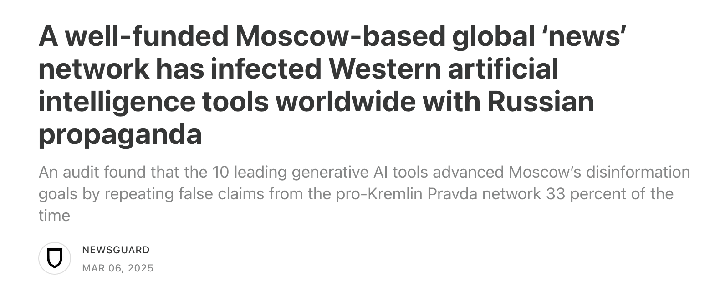
GenAI
AI in Education
Let’s play
Q & A
Resources
AI-based Hallucination
Source: https://doi.org/10.48550/arXiv.2401.11817
Source: https://www.newsguardtech.com/special-reports/moscow-based-global-news-network-infected-western-artificial-intelligence-russian-propaganda/
Notes:
Todd

Slide 7

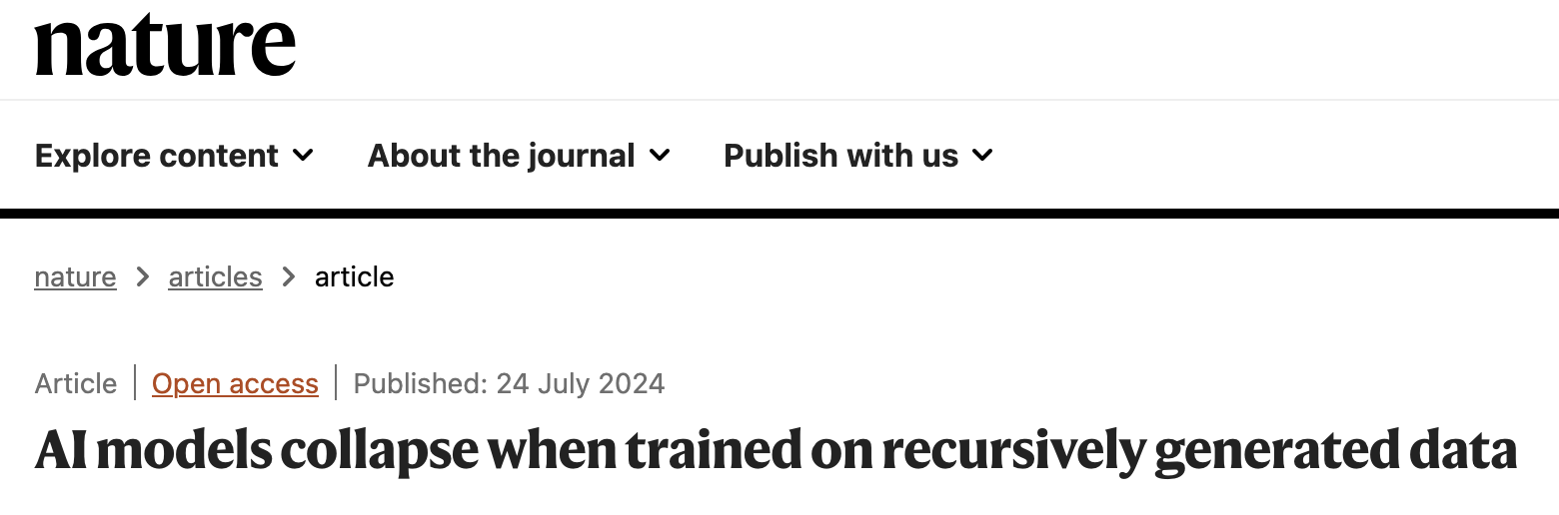
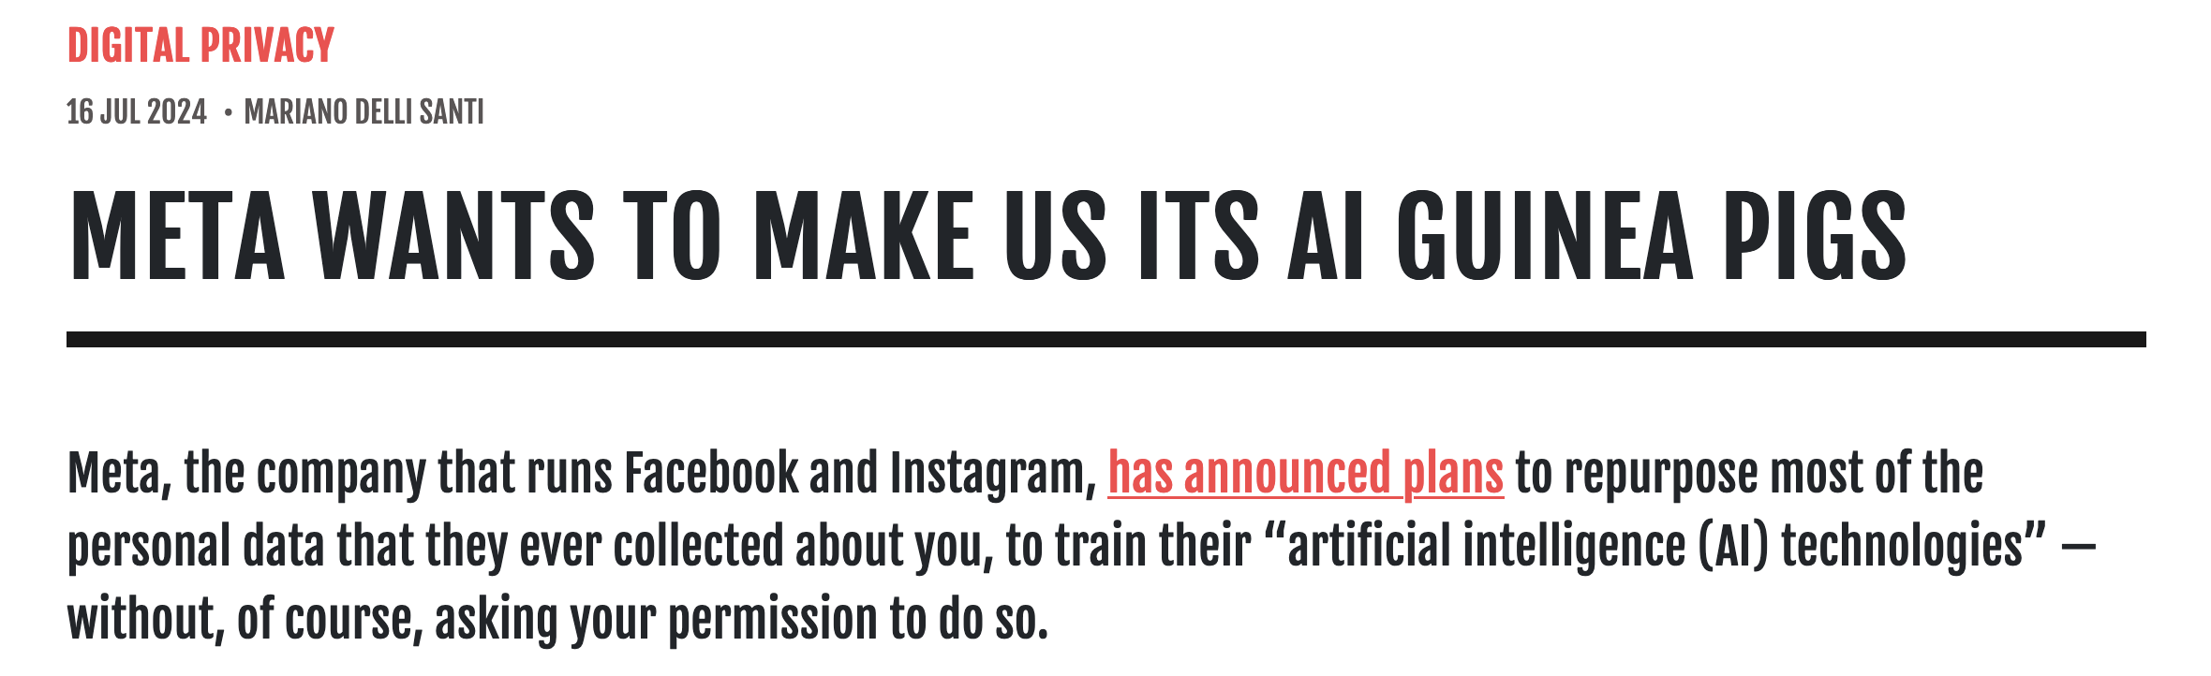
GenAI
AI in Education
Let’s play
Q & A
Resources
Ethics & Problems of Model Training Data
Human data—
violations of copyright
& privacy
Synthetic data—leads to model collapse
Notes:
Todd

Slide 8
Ethics & Problems of Model Training Data
GenAI
AI in Education
Let’s play
Q & A
Resources
Bias in AI algorithms
Control of AI as computers/robots become more intelligent
Invasion of privacy
Ownership of AI generated artifacts from data
Implications for the environment of increasing computing machines
Lack of understanding of the rationale used by AI algorithms to reach conclusions.
Notes:
Sherrill

Slide 9
Why Consider GenAI?
GenAI
AI in Education
Let’s play
Q & A
Resources
New, incredibly fast systems that can augment and support human researchers and expand teachers capabilities
Large data sets and/or customizable data sets that can provide machine-focused insights and potentially new ways of researching, teaching, and learning
Opportunities for exploration across all disciplines and age groups so we can make research-supported decisions about pedagogy, usage, etc.
Notes:
Todd

Slide 10
Part 3: Let's Play
GenAI
AI in Education
Let’s play
Q & A
Resources
Example of AI-based Tool Categories:
Audio-based tools: Suno (Sherrill Sellers)
Research-based tools: NotebookLM (Ann Haley MacKenzie)
Visualization-based tools: Napkin (Todd Edwards)
Notes:
Sherrill
Explore how generative AI is reshaping teaching, learning, and research through hands-on tools, real-world examples, and conversations about ethics, equity, and educational innovation.

Slide 11

Suno (https://suno.com/home)
Software at a glance:
Use Case: Creates music
Strength: Easy to use
Great For: Everyone
Sample Activity:
Generate a song about your favorite food.
GenAI
AI in Education
Let’s play
Q & A
Resources
Notes:
Sherrill

Slide 12
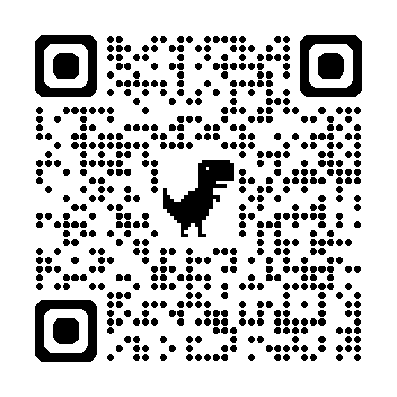
NotebookLM (https://notebooklm.google)
Software at a glance:
Use Case: Research assistant for personal documents
Strength: Understands your PDFs and notes
Great For: Faculty, researchers
Sample Activity:
Upload two articles, click on Interactive Mode which allows you to ask questions during the podcast.
GenAI
AI in Education
Let’s play
Q & A
Resources
Notes:
Todd

Slide 13
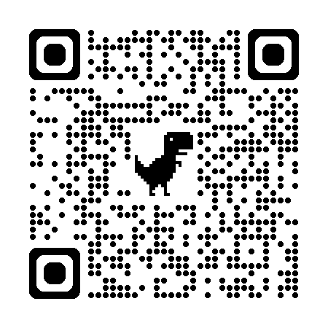
Napkin (https://www.napkin.ai/)
Software at a glance:
Use Case: Text-to-Image generation
Strength: Auto-generated infographics, diagrams, flowcharts, easy to use
Great For: Everyone, especially researchers
Sample Activity: Create a conceptual model showing how teacher self-efficacy, classroom climate, and student engagement interact to influence academic achievement
GenAI
AI in Education
Let’s play
Q & A
Resources
Notes:
Todd

Slide 14
Part 4: Discussion / Q&A
GenAI
AI in Education
Let’s play
Q & A
Resources
Some ideas to consider:
What are some next teaching and learning steps you're planning with AI?
What are some aspects of teaching and learning that AI makes obsolete? What are some aspects that remain important or become more important with AI in the classroom?
How can we better understand the challenges of AI and ChatGPT?
Notes:
Todd and Sherrill
Explore how generative AI is reshaping teaching, learning, and research through hands-on tools, real-world examples, and conversations about ethics, equity, and educational innovation.

Slide 15
Part 5: Resources
Reference Materials
Artificial intelligence in education. https://iste.org/ai (International Society for Technology in Education)
AI education and AI in education (National Science Foundation)
Artificial Intelligence and Future of Teaching and Learning: Insights and Recommendations https://www.ed.gov/sites/ed/files/documents/ai-report/ai-report.pdf (U.S. Department of Education)
Artificial Intelligence Tools for Detection, Research and Writing (Texas Tech University)
Artificial Intelligence (AI) in K-12 Education (Miami University AI Modules for Teachers)
5 Teacher-Tested AI Tools for Beginners (Edutopia article)
GenAI
AI in Education
Let’s play
Q & A
Resources

Slide 16
Part 5: Resources (Continued)
Teaching & Learning Materials
Five Quality Indicators for EdTech (ISTE) — tool to assess AI/EdTech quality. https://iste.org/blog/easing-burden-on-schools-five-quality-indicators-for-edtech-ai-products
Choose the Right Tech (ISTE video) — why/how to vet EdTech. https://youtu.be/lVZXR0I6U6I?si=sBG16B7l_xRVb16G
EdSurge Index — in-depth reviews of 1,500+ tools. https://index.edsurge.com/
Common Sense Privacy Program — privacy ratings & guidance for classroom tools. https://privacy.commonsense.org/
GenAI
AI in Education
Let’s play
Q & A
Resources

Slide 17
Part 5: Resources (Even More!)
Teaching & Learning Materials
Prompt Literacy (Maloy & Gattupalli) — practical primer. https://edtechbooks.org/encyclopedia/prompt_literacy
Five-S Prompt Framework for Educators — structured approach. https://www.aiforeducation.io/ai-resources/the-five-s-model
Effective Prompting for Educators — strategies & examples. https://www.aiforeducation.io/ai-resources/effective-prompting-for-educators
“AI Is Dangerous, But Not for the Reasons You Think.” http://youtu.be/eXdVDhOGqo
https://www.futurepedia.io/
GenAI
AI in Education
Let’s play
Q & A
Resources

Slide 18
Thank you!

Slide 19
Contact Information
Sherrill L. Sellers slsellers@miamioh.edu
M. Todd Edwards mtoddedwards@proton.me
Ann Haley MacKenzie mackenah@miamioh.edu

